Slide 1
Controlling Types and Process

Slide 2
Learning Outcomes
Students will analyze types of controlling

Slide 3
Controlling
Controlling is one of the important functions of a manager. In order to seek planned results from the subordinates, a manager needs to exercise effective control over the activities of the subordinates.
In other words, the meaning of controlling function can be defined as ensuring that activities in an organization are performed as per the plans. Controlling also ensures that an organization’s resources are being used effectively & efficiently for the achievement of predetermined goals.

Slide 4
Types of Controlling
1. Budgetary Control:
Budgeting refers to the plans and expected results in the form of numerical information. It helps in understanding and expressing the future results of the projects in numerical form. For example, the number of sales, production output, etc.
2. Standard Costing:
Standard costing is similar to budgeting, it also works on numerical figures. Standard costing includes the estimated costs for all activities within an organization.
3. Break-Even Analysis:
Break-even analysis Indicates the point at which a business lies in no profit no loss situation. It can be in the form of the price of products, sale output, production volume.
4. Statistical Control:
It understands an organization’s tasks effectively and efficiently. The averages, percentages, and ratios using graphs and charts. represents the organizational performance in an easy way.

Slide 5
Controlling
Category of Controlling
Feed-Forward Controls
Feed forward controls are future-directed — they attempt to detect and anticipate problems or deviations from the standards in advance of their occurrence (at various points throughout the processes). They are in-process controls and are much more active, aggressive in nature, allowing corrective action to be taken in advance of the problem.
Feed forward controls thus anticipate problems and permit action to be taken before a problem actually arises.

Slide 6
Controlling
Concurrent (Prevention) Control:
Concurrent control, also called steering control because it allows people to act on a process or activity while it is proceeding, not after it is proceeding, nor after it is completed. Corrections and adjustments can be made as and when the need a rises. Such controls focus on establishing conditions that will make it difficult or impossible for deviations from norms to occur.

Slide 7
Controlling
Feedback Controls:
Feedback control is future-oriented. It is historical in nature and is also known as post-action control. The implication is that the measured activity has already occurred, and it is impossible to go back and correct performance to bring it up to standard. Rather, corrections must occur after the act.
The basic objective is to help prevent mistakes in the future.

Slide 8
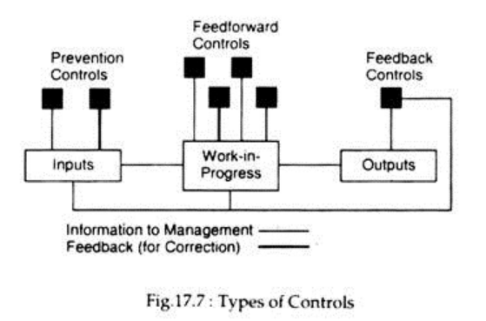
Controlling

Slide 9
Process of Controlling
1. Establishing goals and standards
The task of fixing goals and standards takes place while planning but it plays a big role in controlling also. This is because the main aim of controlling is to direct a business’s actions towards its goals. If the members of an organization know their goals clearly, they will invest their entire focus in achieving them.
The goals that managers have to set and work towards may be either tangible/specific or intangible/abstract.

Slide 10
Process of Controlling
2. Measuring actual performance against goals and standards
Once managers know what their goals are, they should next measure their actual performance and compare. This step basically helps them in knowing whether their plans are working as intended.
After implementing a plan, managers have to constantly monitor and evaluate them. They must always be ready to take corrective measures if things are not working properly. In order to do this, they should keep comparing their actual performance with their ultimate goals.

Slide 11
Process of Controlling
3. Taking corrective action
In case there are discrepancies between actual performances and goals, managers need to take corrective actions immediately. Timely corrective actions can reduce losses as well as prevent them from arising in the future again.
Sometimes, business organizations formulate default corrective actions in the form of policies. This, however, can be difficult to do when it comes to complicated problems.

Slide 12
Process of Controlling
4. Following up on corrective action
Just taking corrective measures is not enough; managers must also take them to their logical conclusion. Even this step requires thorough evaluations and comparisons.
Managers should stick to the problem until they solve it. If they refer it to a subordinate, they must stay around and see to it that he completes the task. They may even mentor him personally so that he may be able to solve such problems by himself later.

